Slide 1
Research in progress
November 2023

Slide 2
Wolbachia project

Slide 3
Aciurina in NM comparison:
- How similar are A. trix and A. bige?
(Phylogeny, basic sequence similarity)
- Phylogeny of A. trix, A. bige, A. nota
- How much genetic exchange do A. trix and A. bige have?
(abba/baba, fst, etc.)
- How does this compare to the A. trix-A. nota and A. bige-A. nota interbreeding?
Does the pattern change when species are in sympatry?
Structure plot of A. trix, A. bige, A. nota – what is the optimum k?
 | MAL | SNM | TES | RGG | ABQ
Atrix |  | 3 | 3 | 3 | 3
Abige | 3 | 3 | 3 | 3
Anota | 3 |  | 3

Slide 4
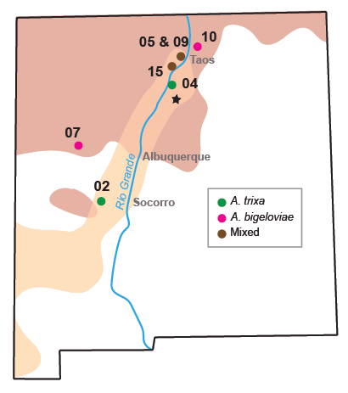
Phylogeny
cotton/bigloviae
Smooth /trixa
notata

Slide 6
How similar are bigeloviae and A. bigeloviae?
Pops | ABQ-S | RGG-S | SNM-S | TES-S | MAL-C | RGG-C | SNM-C | TES-C | MAL-N | TES-N
ABQ-S
RGG-S | 0.085788
SNM-S | 0.16891 | 0.14525
TES-S | 0.061497 | 0.019541 | 0.13686
MAL-C | 0.55291 | 0.53482 | 0.56275 | 0.53503
RGG-C | 0.51847 | 0.49764 | 0.52589 | 0.49839 | 0.10155 | -
SNM-C | 0.57859 | 0.55862 | 0.59019 | 0.56132 | 0.069921 | 0.14915
TES-C | 0.54348 | 0.52498 | 0.55246 | 0.52433 | 0.13136 | 0.026005 | 0.18147
MAL-N | 0.80235 | 0.79907 | 0.81044 | 0.797 | 0.77096 | 0.75875 | 0.78449 | 0.77451
TES-N | 0.79801 | 0.79312 | 0.80775 | 0.79241 | 0.76466 | 0.75225 | 0.77767 | 0.76928 | 0.034341
Notes:
The fixation index (F_{ST}) is a measure of population differentiation due to genetic structure. Its values range from 0 to 1. By estimating pairwise FST, Jost’s D, PCA, and the number of private alleles (PA) as above for GAs. For these tests, if taxa have experienced hybridization, then we expect to detect low fixation indices (< 0.05), indistinct clusters and overlapping PC scores on primary axes, and relatively few private alleles (< 1%). If, however, genomes have not mixed, we expect to detect relatively high fixation indices (> 0.05), distinct clusters of variation without overlapping PC scores on primary PC axes, and an elevated fraction of private alleles (1- 10%).

Slide 7
Structure plot – what is the optimum k?

Slide 9
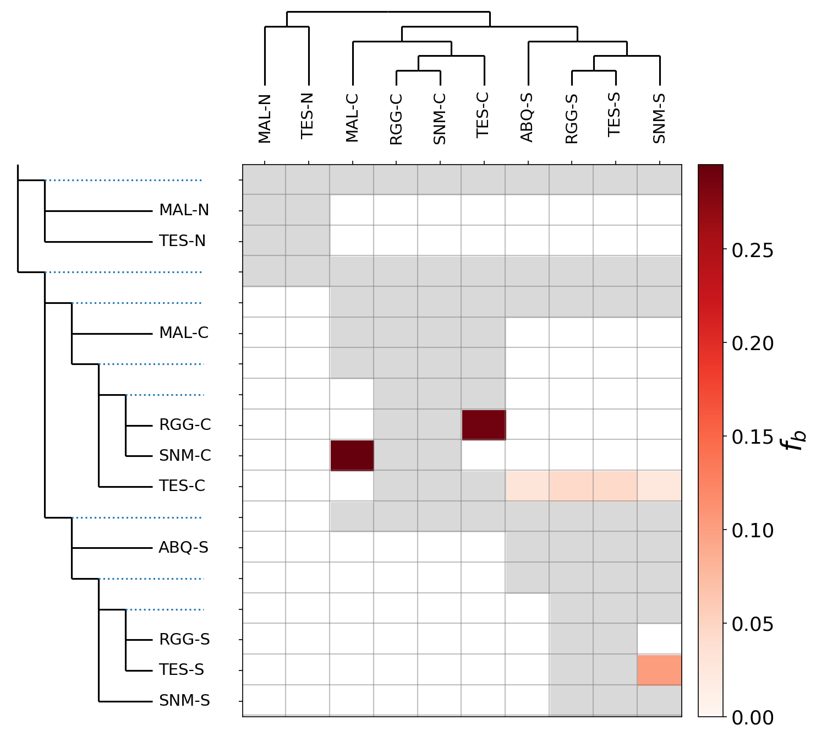
Notes:
Darker colors mean higher allele sharing between groups.

Slide 10
P1 | P2 | P3 | Dstatistic | Z-score | p-value | f4-ratio | BBAA | ABBA | BABA
ABQ-S | MAL-C | MAL-N | 0.0262659 | 0.283393 | 0.776875 | 0.00220934 | 350.986 | 26.3194 | 24.9722
MAL-C | RGG-C | ABQ-S | 0.0360275 | 0.80779 | 0.419211 | 0.0158892 | 153.587 | 52.9201 | 49.2396
ABQ-S | RGG-S | MAL-C | 0.0812557 | 1.96758 | 0.0491167 | 0.0336032 | 225.37 | 38.3495 | 32.5856
SNM-C | MAL-C | ABQ-S | 0.052095 | 1.4202 | 0.155551 | 0.020106 | 170.957 | 47.8947 | 43.1516
ABQ-S | SNM-S | MAL-C | 0.0119144 | 0.28006 | 0.779431 | 0.00478741 | 220.451 | 34.7986 | 33.9792
MAL-C | TES-C | ABQ-S | 0.0863015 | 1.60862 | 0.1077 | 0.0375211 | 153.812 | 54.3264 | 45.6944
ABQ-S | MAL-C | TES-N | 0.0234983 | 0.255688 | 0.798192 | 0.00194566 | 338.969 | 25.559 | 24.3854
ABQ-S | TES-S | MAL-C | 0.089777 | 2.54984 | 0.0107772 | 0.0366802 | 228.395 | 38.1863 | 31.8947
ABQ-S | RGG-C | MAL-N | 0.0667452 | 0.788343 | 0.430496 | 0.00557974 | 355.81 | 27.2477 | 23.838
ABQ-S | RGG-S | MAL-N | 0.110188 | 1.60216 | 0.109119 | 0.00451754 | 510.785 | 13.9236 | 11.1597
ABQ-S | SNM-C | MAL-N | 0.0321042 | 0.398349 | 0.690373 | 0.00285285 | 346.503 | 27.7951 | 26.066
ABQ-S | SNM-S | MAL-N | 0.0110358 | 0.150403 | 0.880447 | 0.00043236 | 506.505 | 12.088 | 11.8241
ABQ-S | TES-C | MAL-N | 0.12844 | 1.47886 | 0.139179 | 0.0111027 | 359.11 | 29.8044 | 23.0197
MAL-N | TES-N | ABQ-S | 0.15154 | 1.93142 | 0.0534312 | 0.00723696 | 569.288 | 14.4062 | 10.6146
Notes:
D-statistic:
This is the D-statistic value, representing the difference in the number of ABBA and BABA patterns in the quartet. Positive values suggest introgression between P1 and P3, while negative values suggest introgression between P1 and P2.
Z-score:
The Z-score is a measure of how many standard deviations an element is from the mean. In the context of D-statistics, it helps assess the significance of the D-statistic. Higher absolute Z-scores indicate a more significant departure from the null hypothesis.
p-value:
The p-value indicates the statistical significance of the D-statistic. Low p-values (typically below a significance threshold like 0.05) suggest that the observed D-statistic is unlikely to have occurred by chance.
f4-ratio:
The f4-ratio is the ratio of the lengths of the two paths in the underlying tree. It is used to identify whether the topology of the tree is consistent with the D-statistic.
BBAA, ABBA, BABA:
These columns represent the counts of different allele patterns in the quartet:
BBAA: Count of sites where the allele pattern is BABA.
ABBA: Count of sites where the allele pattern is ABBA.
BABA: Count of sites where the allele pattern is BABA.

Slide 11
Tree Mix
Notes:
TreeMix is a program for the inference of patterns of population splitting and mixing from genome- wide allele frequency data. If given a set of allele frequencies from a number of populations, it will return the maximum likelihood tree for the set of populations, and optionally attempt to infer a number of admixture events.

Slide 12
Tree Mix
Weight | Jackknife | Weight Jackknife | P-Value | Subtree_Origin | Subtree_Destination
0.06793 | 0.0681393 | 0.0421228 | 0.0528707 | (SNM-C:0,MAL-C:0):0.00226923 | SLV-O:0.0950648
0.20195 | 0.168723 | 0.276667 | 0.270984 | ((SNM-C:0,MAL-C:0):0.00226923, | (TES-C:0,RGG-C:0):0.000248248):0.0140571 RGG-C:0
0.01881 | 0.0188254 | 0.0102354 | 0.0329394 | RGG-C:0 | (RGG-S:0,TES-S:0):0
0.22509 | 0.223067 | 0.517725 | 0.333285 | ABQ-S:0 | RGG-S:0
Notes:
Weight:
A weight close to 1 indicates strong gene flow or migration between the populations.
A weight close to 0 suggests limited or no gene flow.
Jackknife Estimates:
The jackknife estimates of the weight and standard error provide information about the uncertainty associated with the weight.
Larger jackknife standard errors may indicate higher uncertainty in the estimation.
P-Value:
The p-value associated with the migration event indicates the statistical significance of the inferred migration.
A smaller p-value (typically below a significance threshold like 0.05) suggests that the migration event is considered statistically significant.

Slide 13
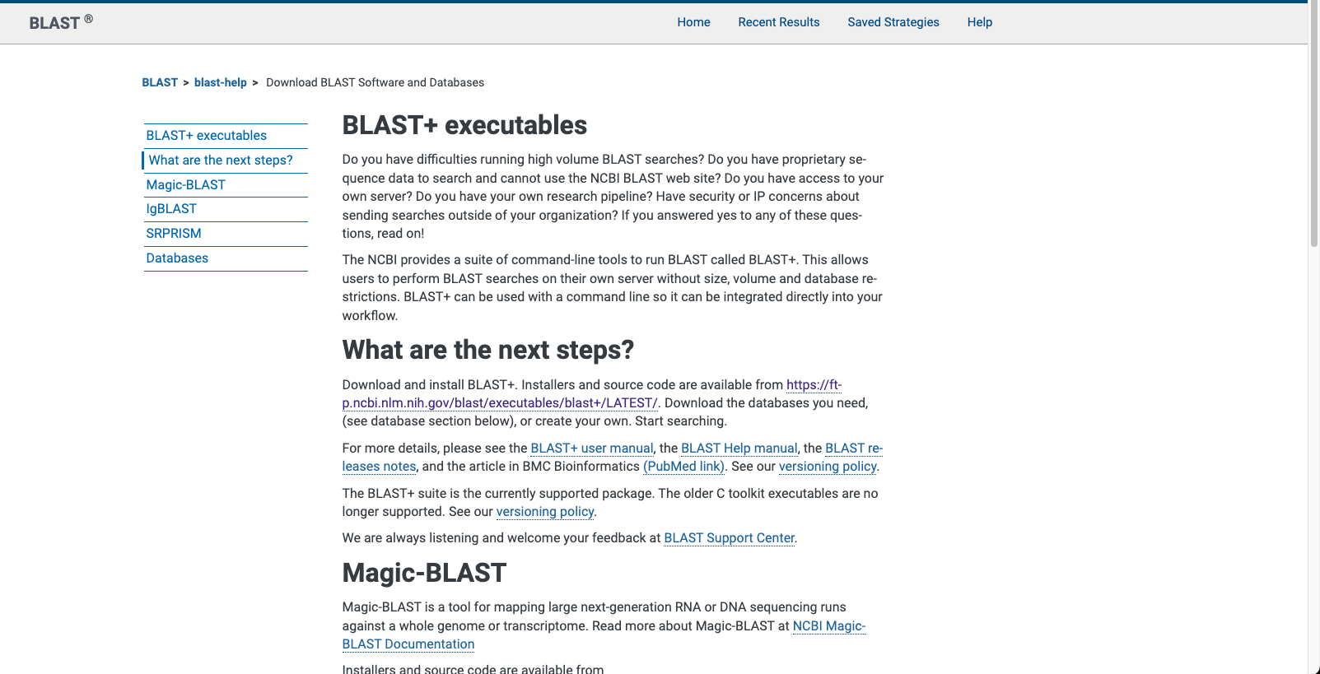
Next steps

Slide 14
Trevor’s data only

Slide 15
Per population
Completeness per sample

Slide 17
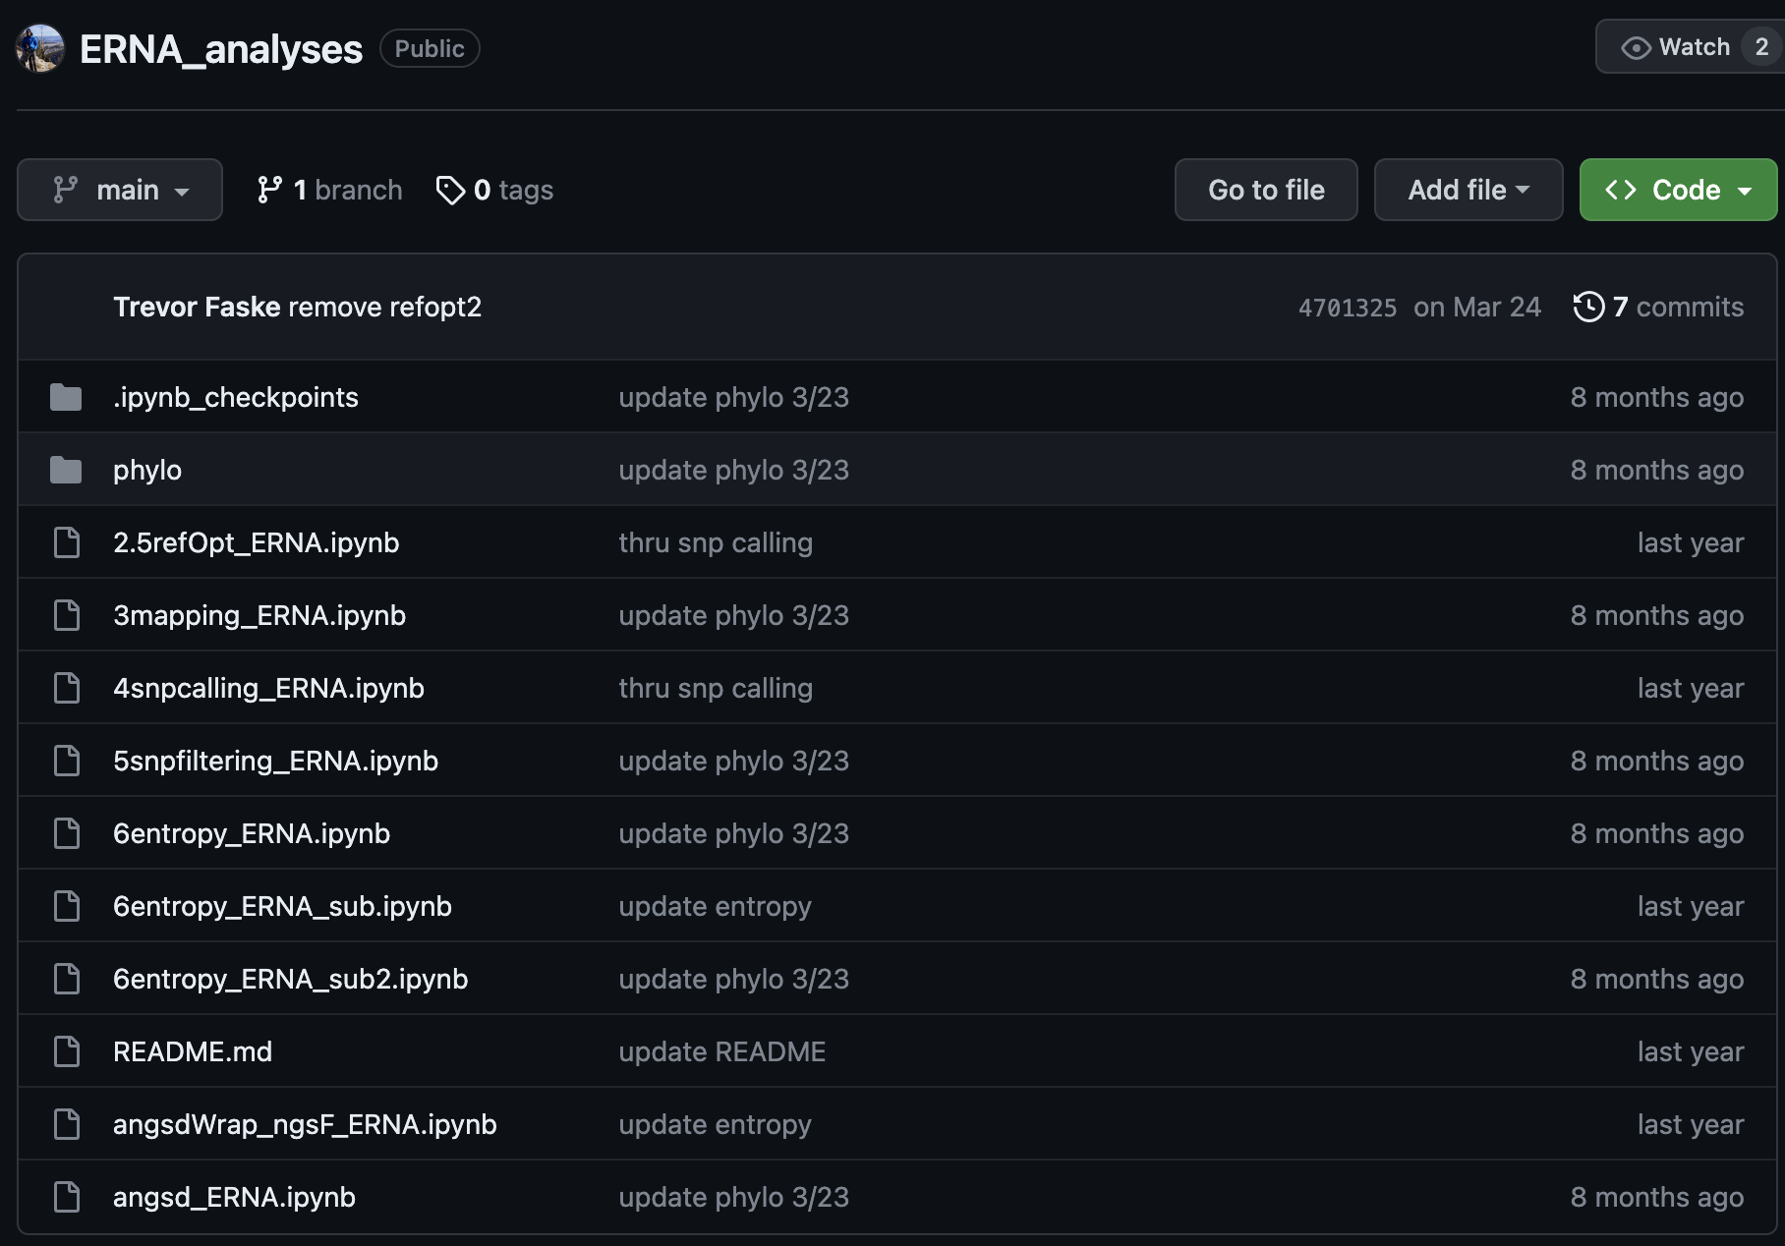
Waiting for Trevor to run our data ☺

Slide 18
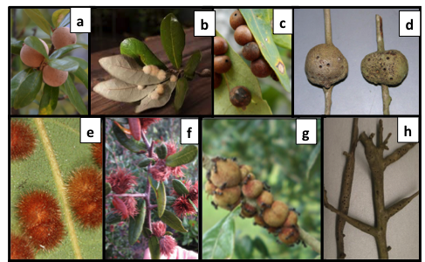
Gall meta transcriptome study

Slide 19
Making a table with:
1. Citation
2. Galling insect/invertebrate scientific name
3. Galling insect/invertebrate common name
4. Host plant species scientific name
5. Host plant species common name
6. Genome or de novo transcriptome assembly of host species
7. Tissue/timepoints samples
8. # of replicates
9. Are reads available on NCBI (most likely SRA database)
10. Notes of anything you think you should add
Notes:
Identify conserved plant response to gall-formation in transcriptomic studies across diverse taxa. Since 2015, >17 transcriptomic studies have been published on different galling species, including the well-studied agricultural systems of grape, wheat, and rice, as well as non-insect galls, such as root knot nematodes; however, none of these studies have been directly compared. We will test the hypothesis that the core plant response genes identified in Aim 2 will be at least partially conserved in other galling system, which will be evaluated with a large bioinformatic meta-analysis.

Slide 20
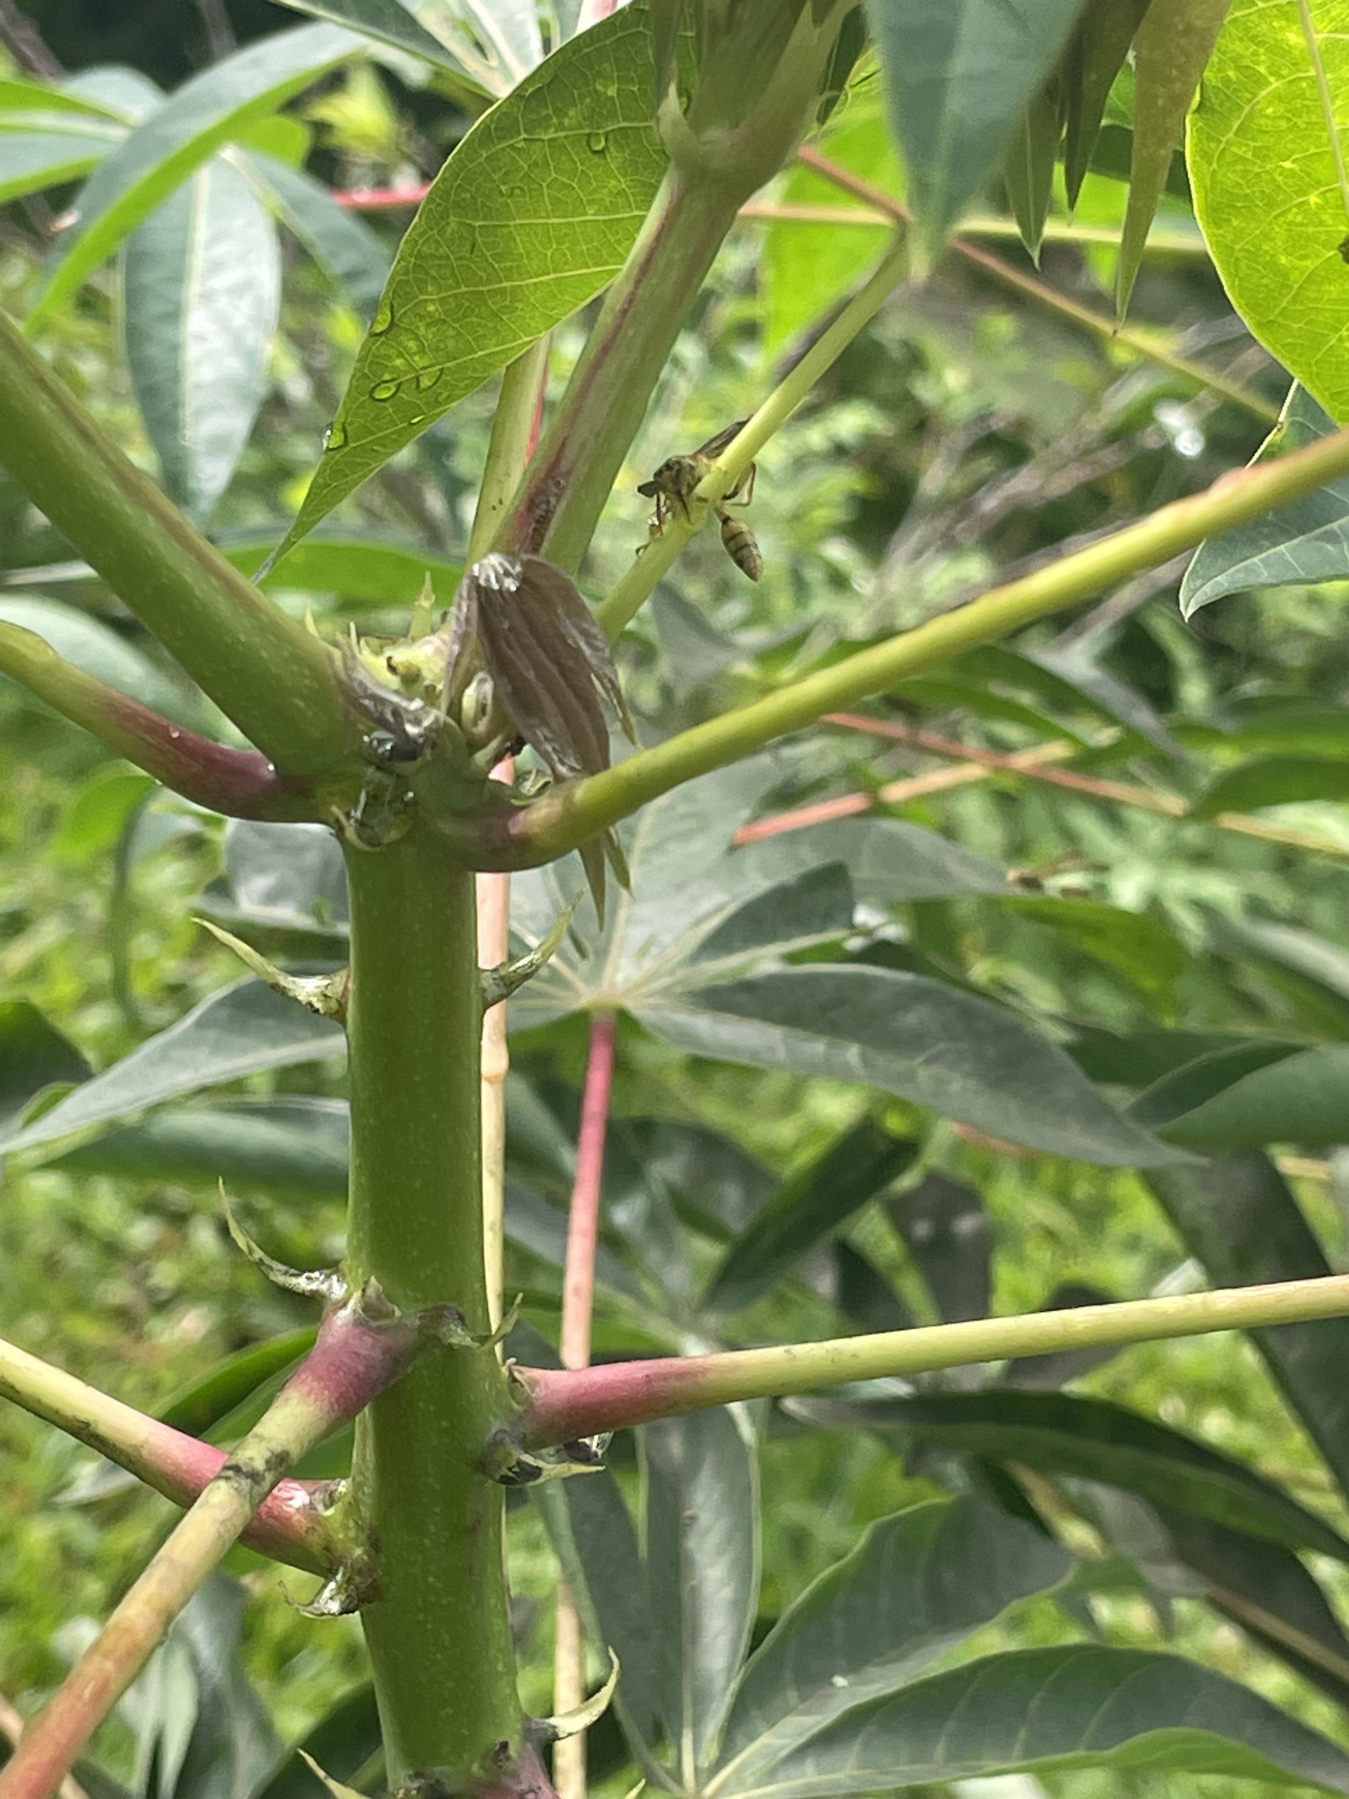
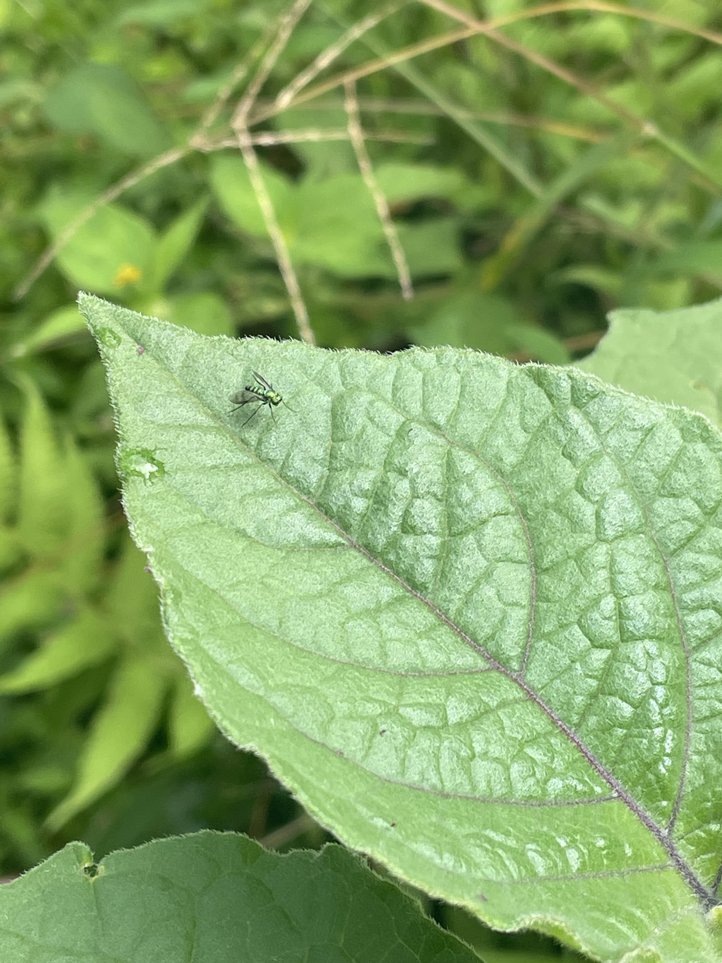
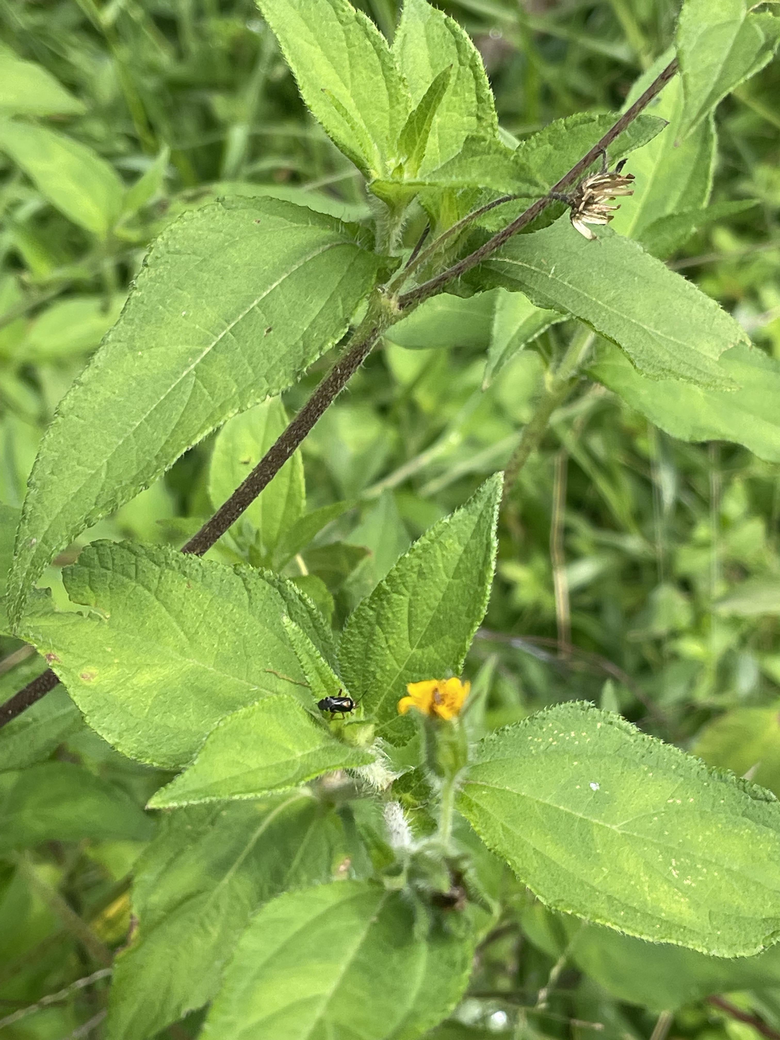
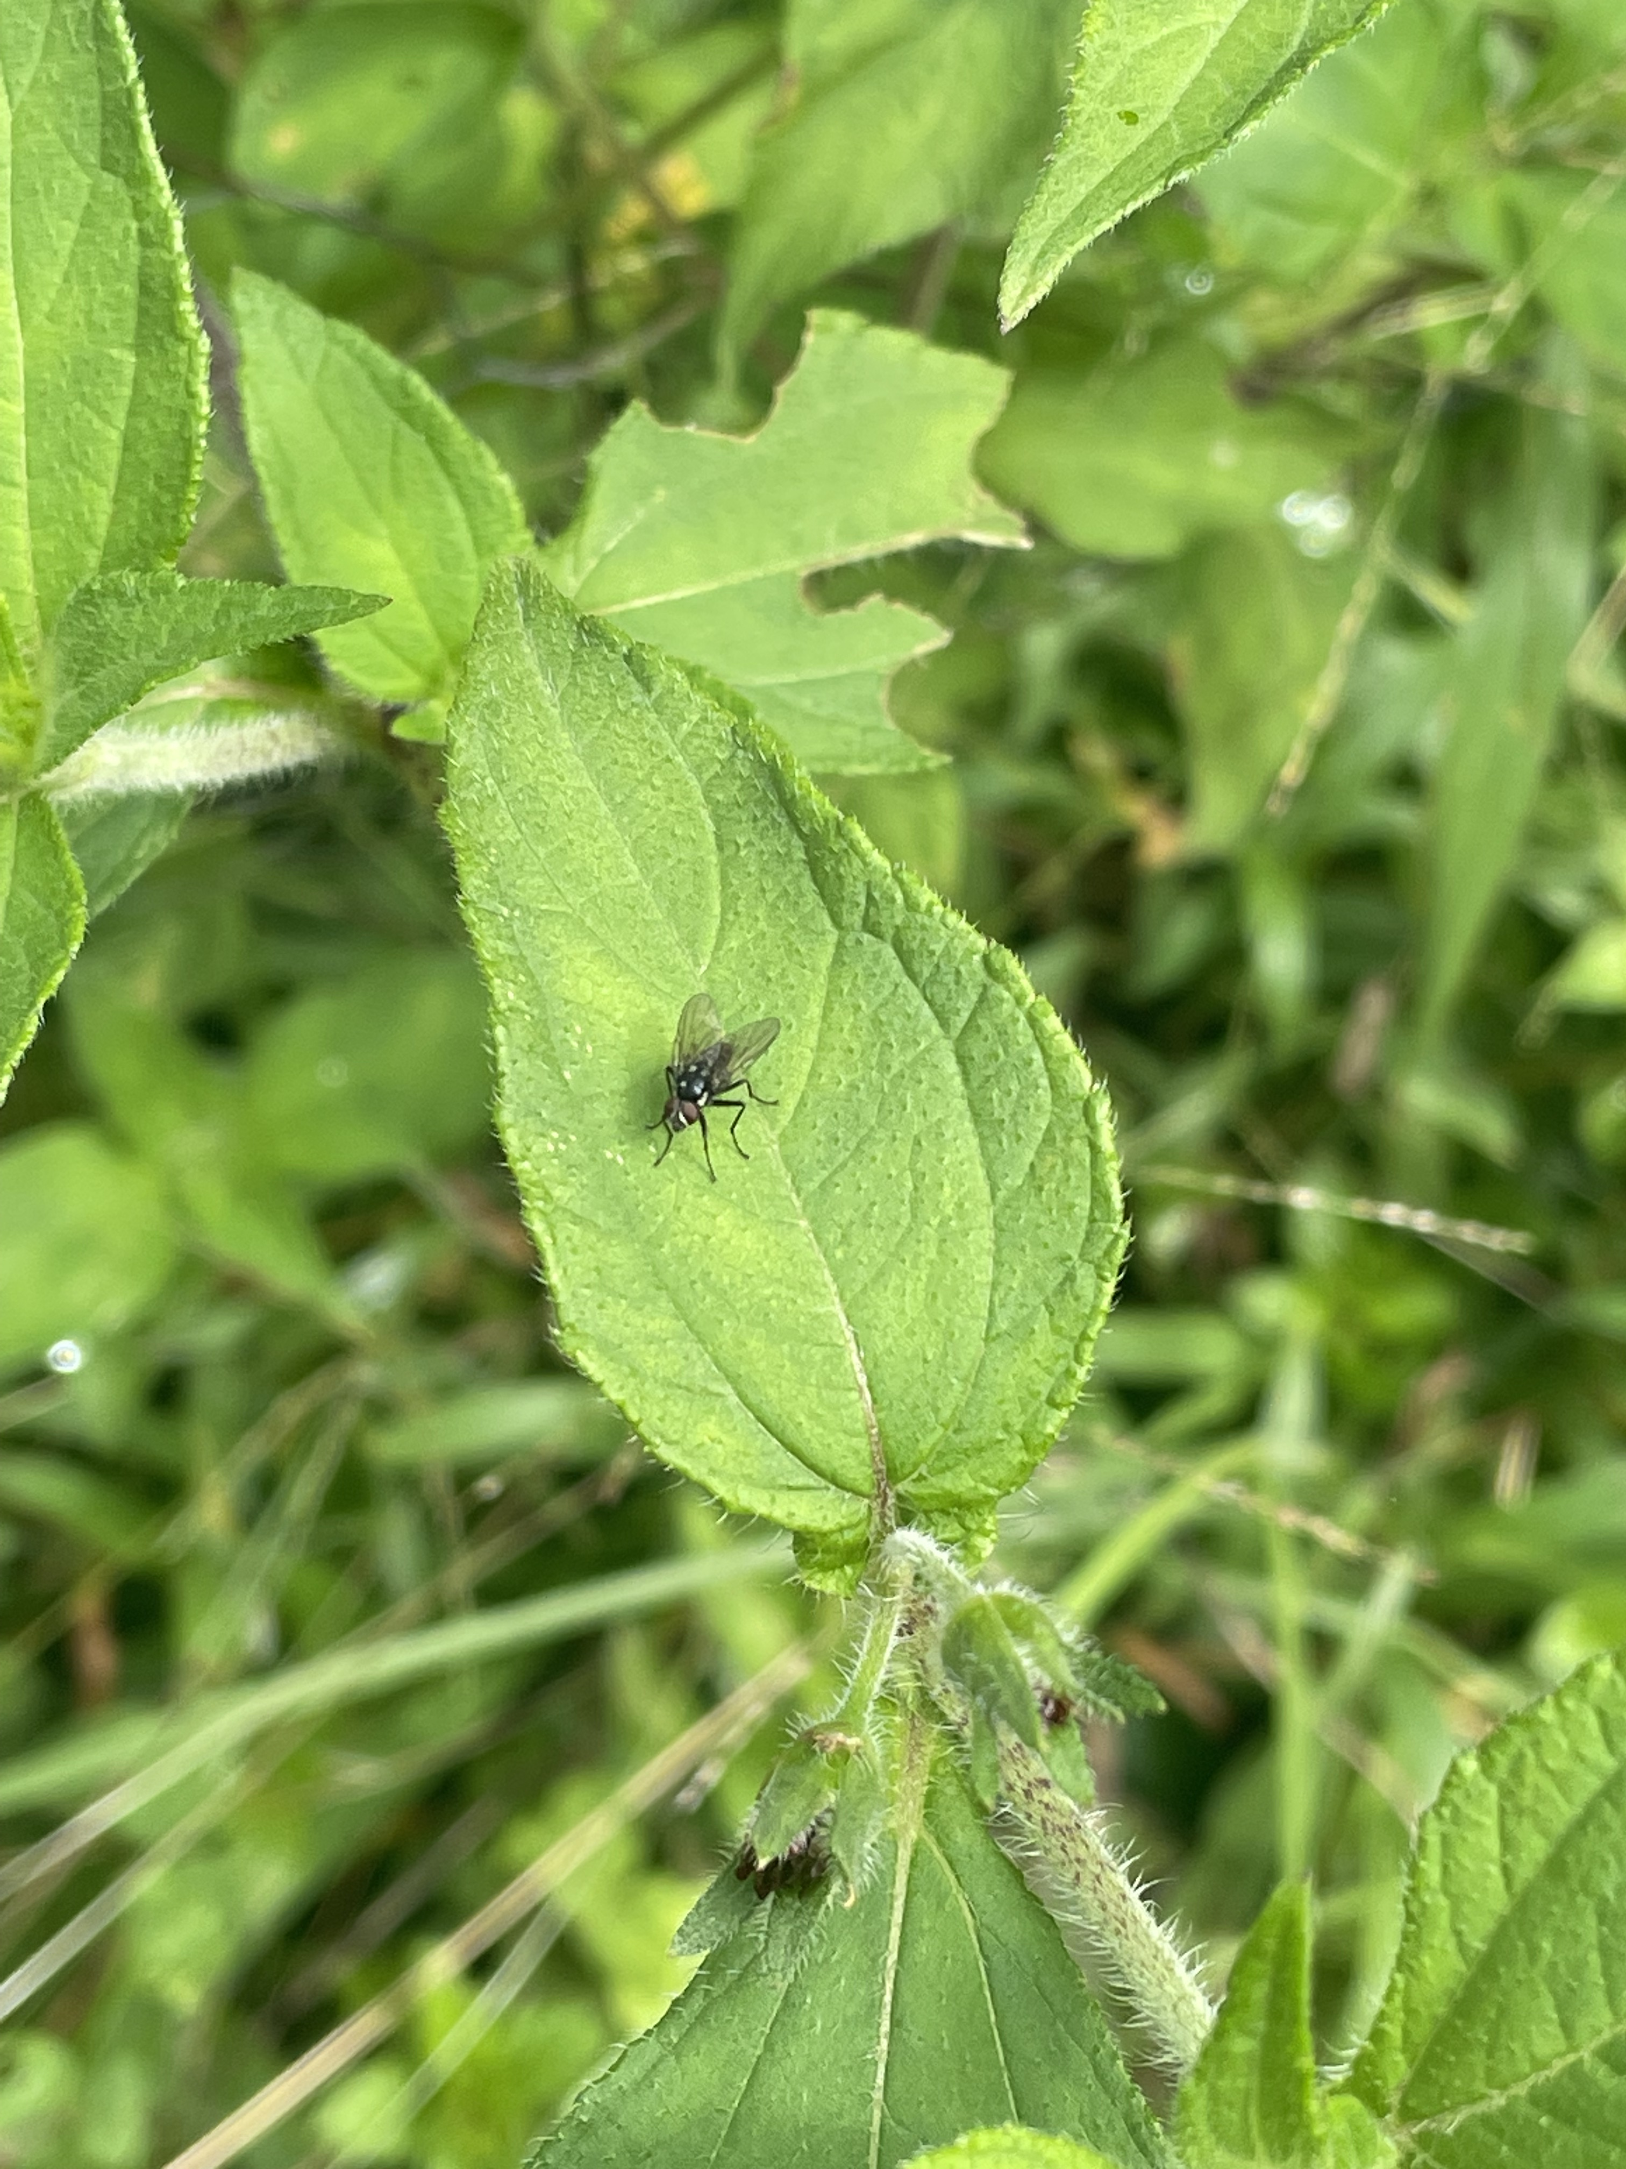
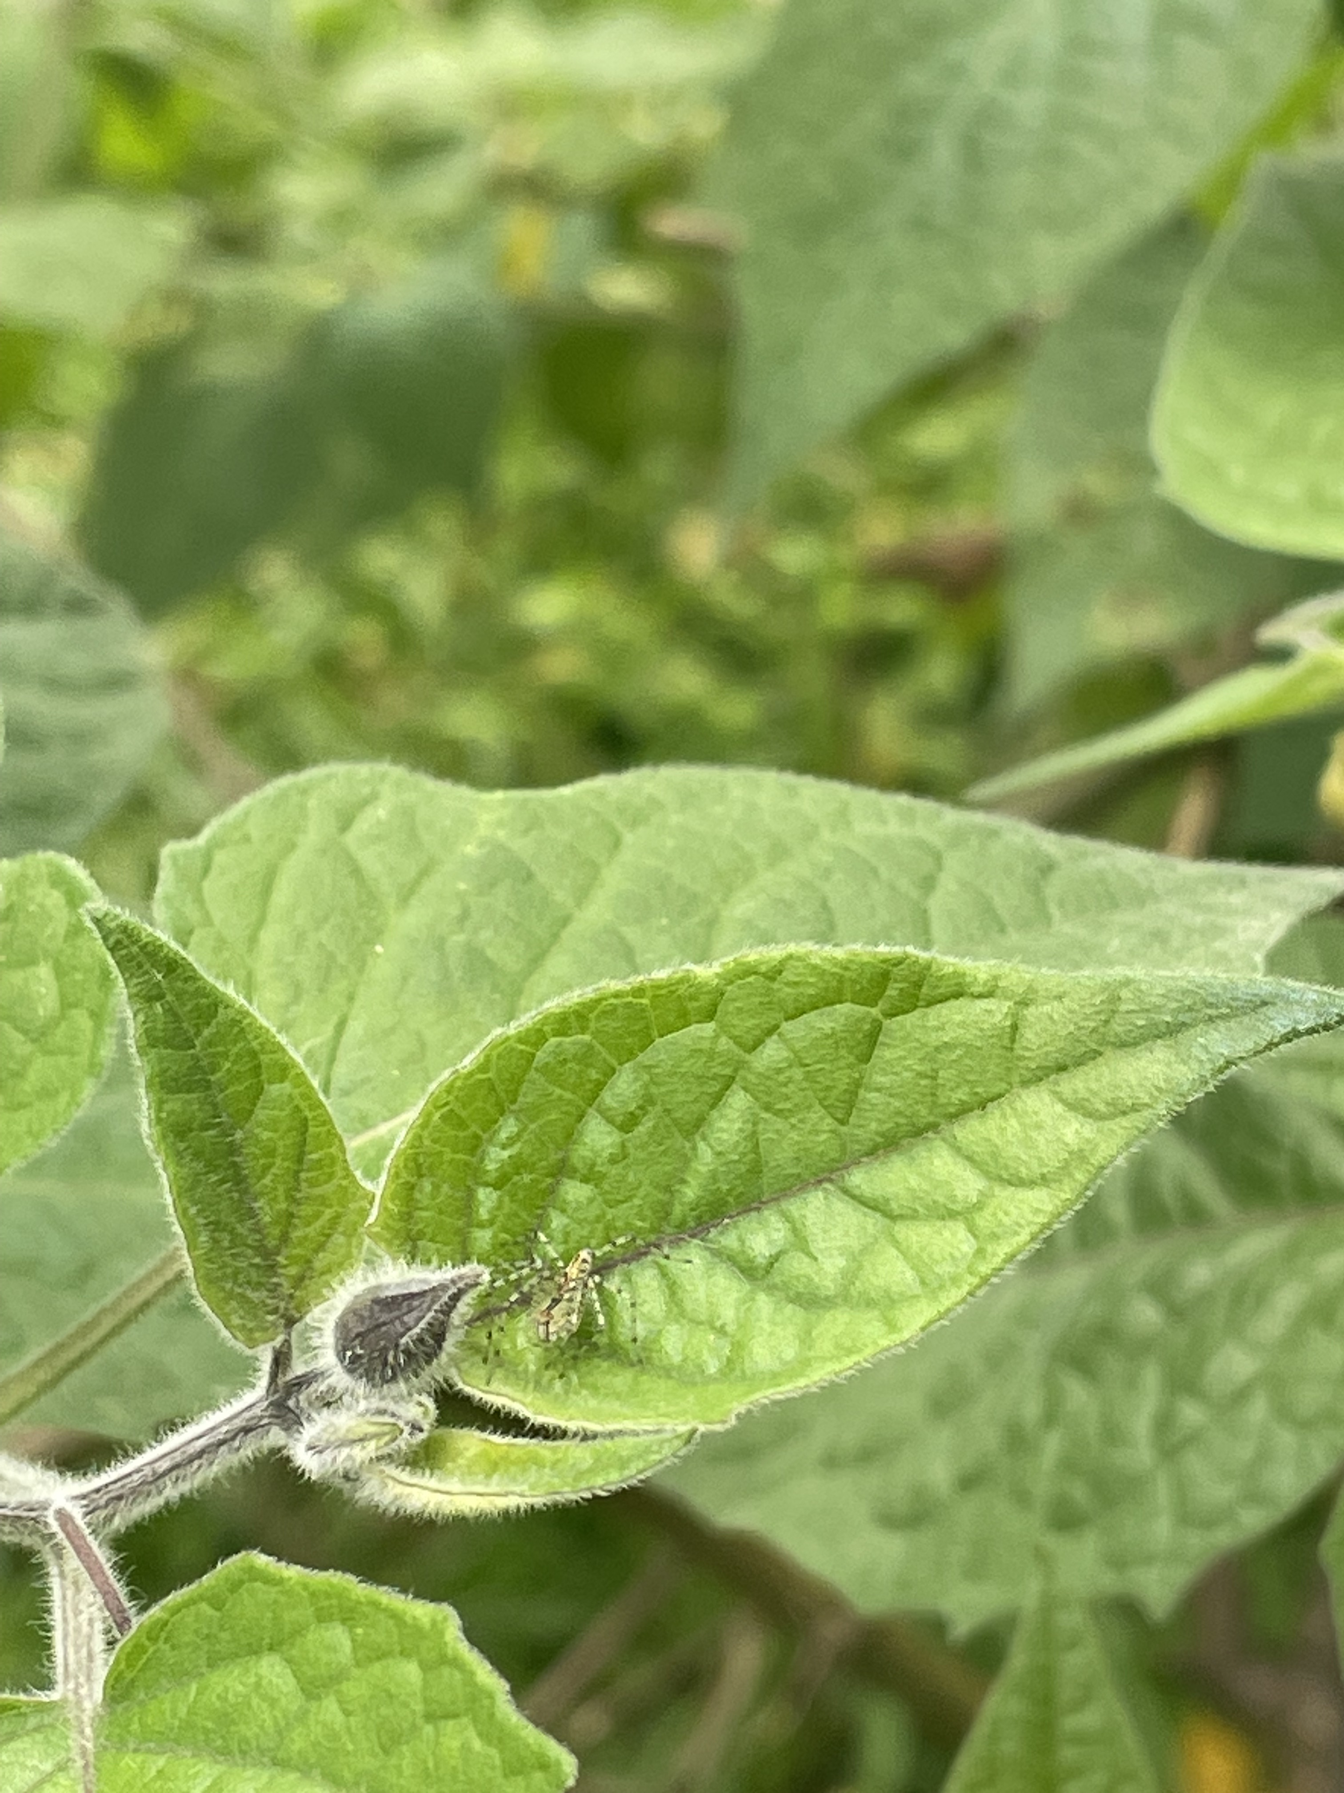
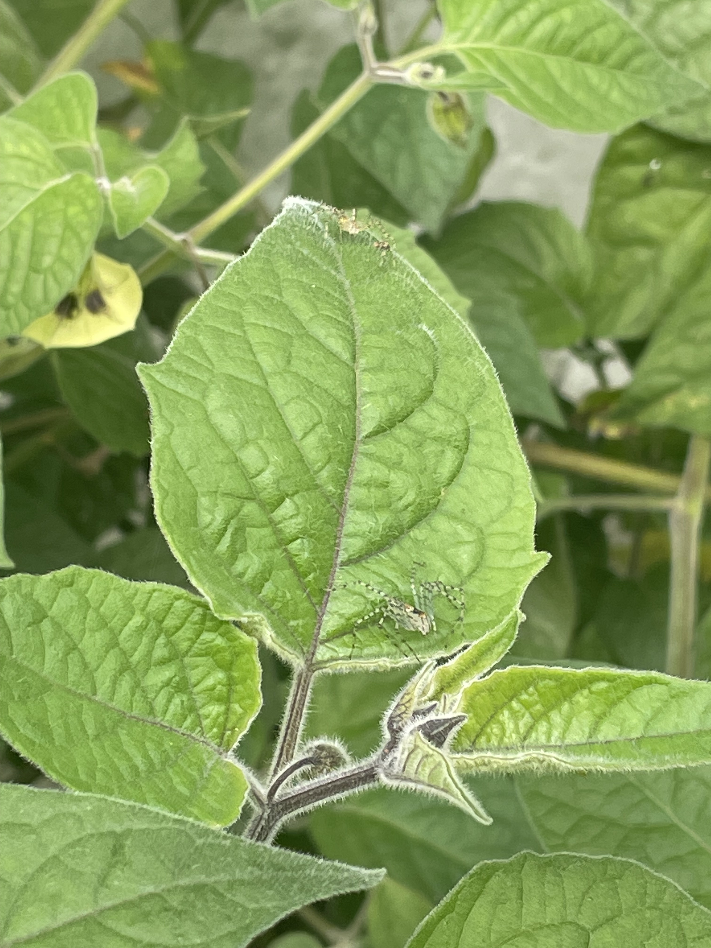
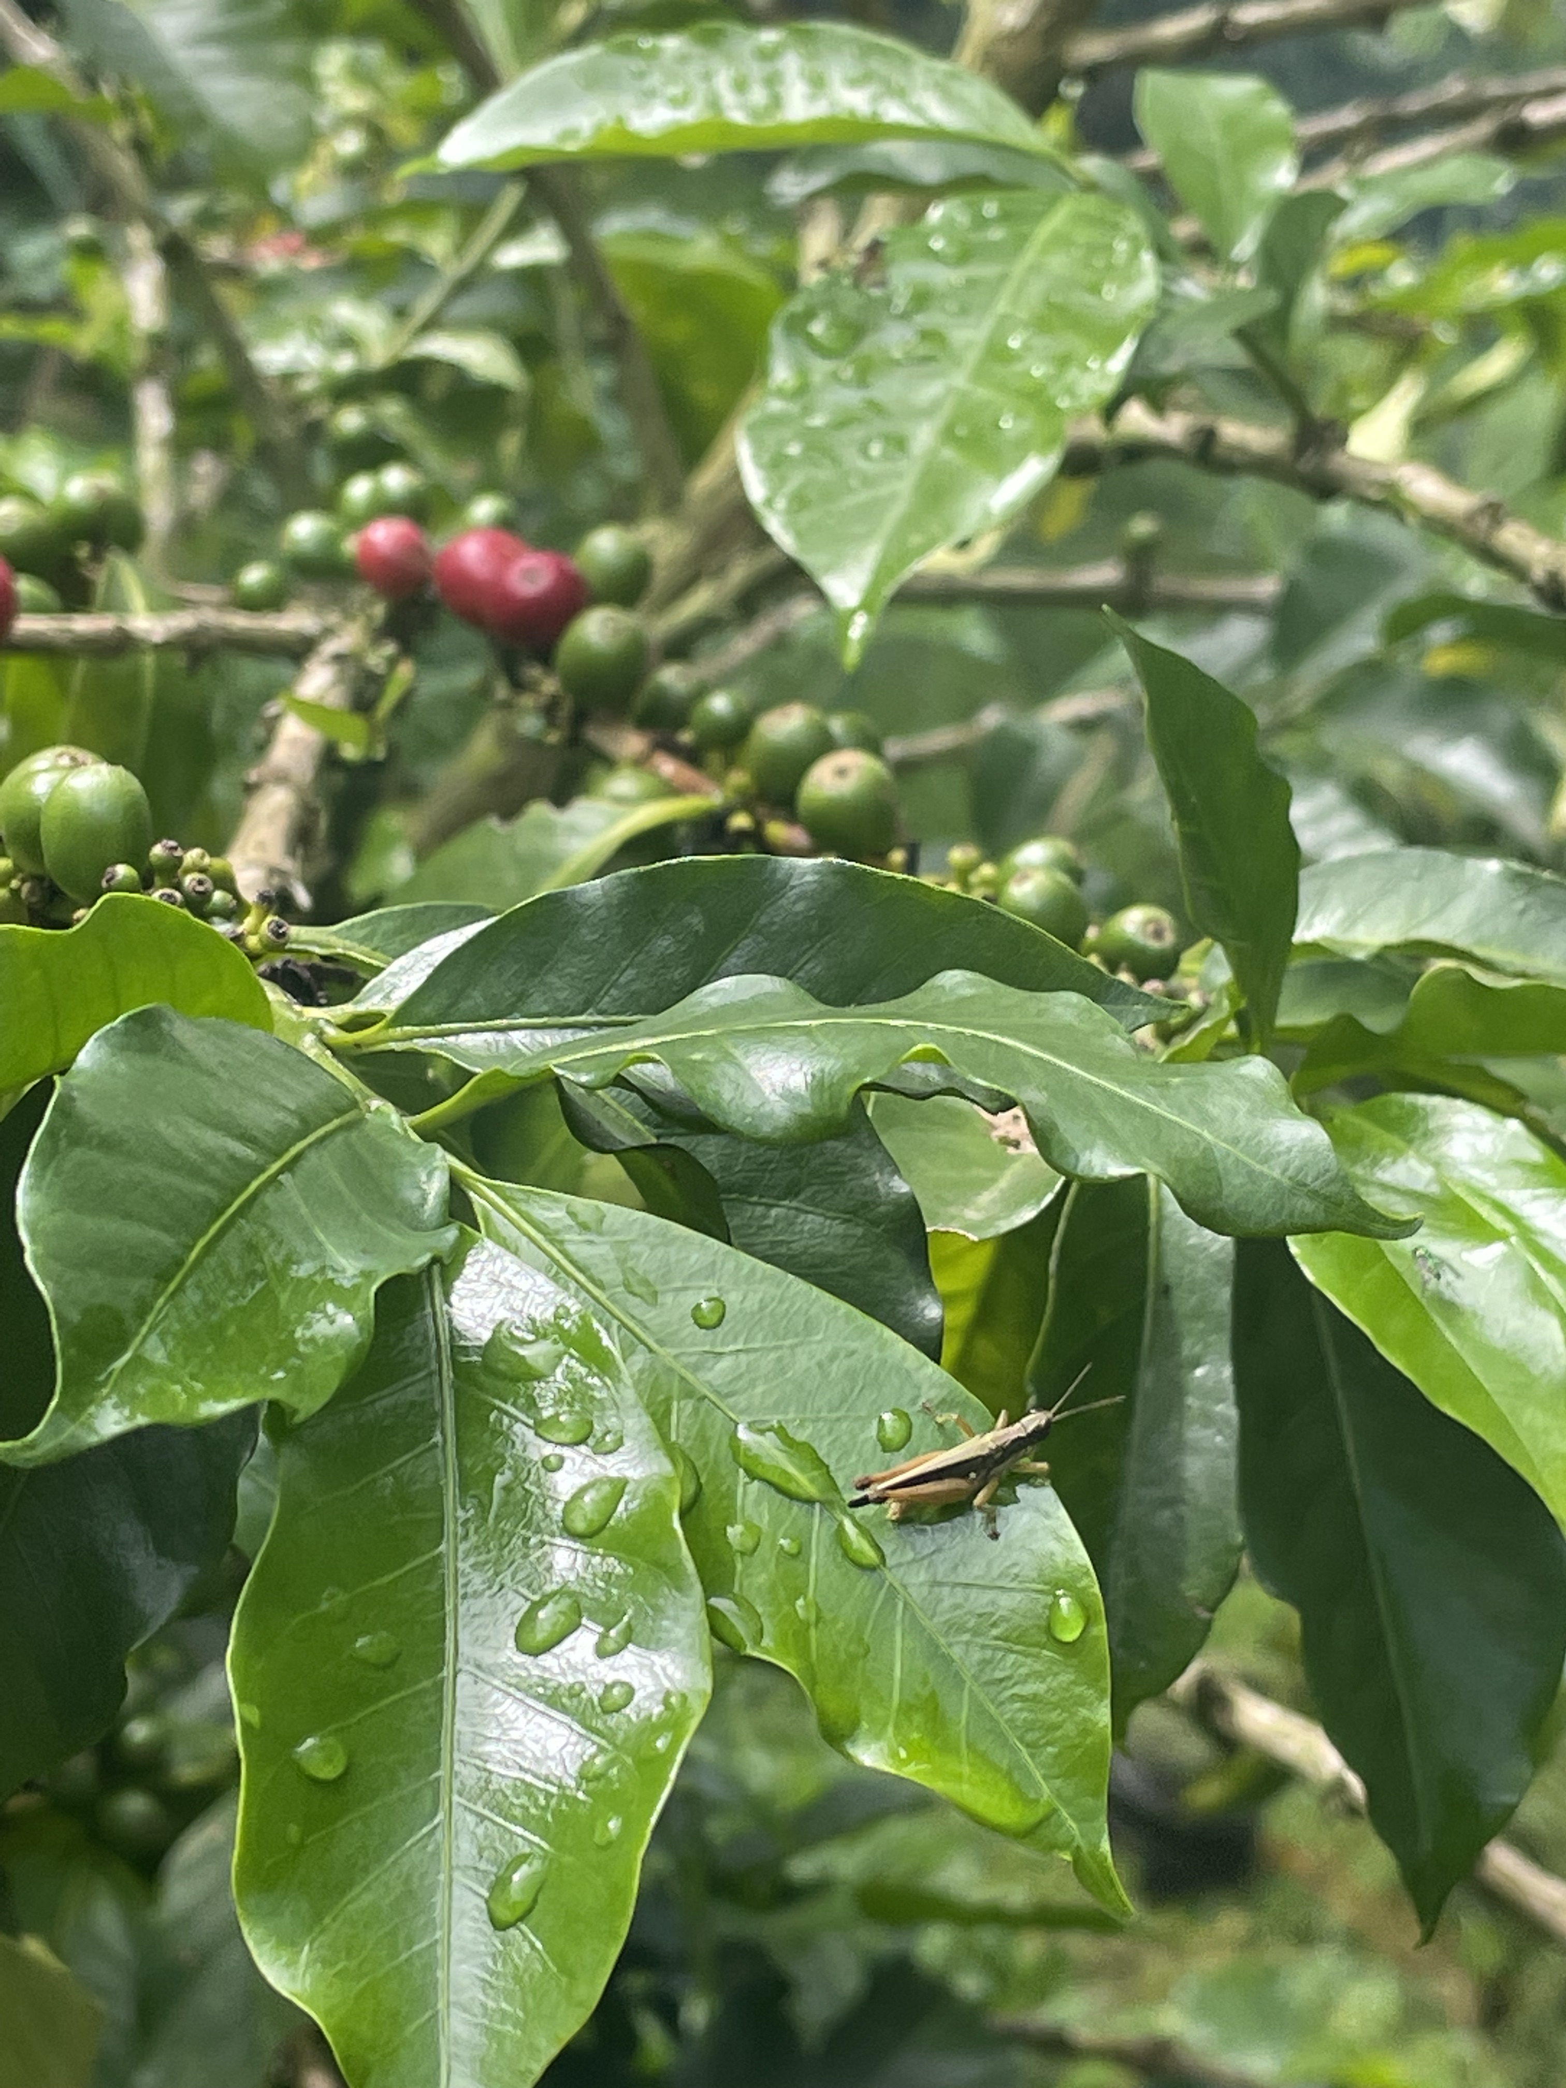
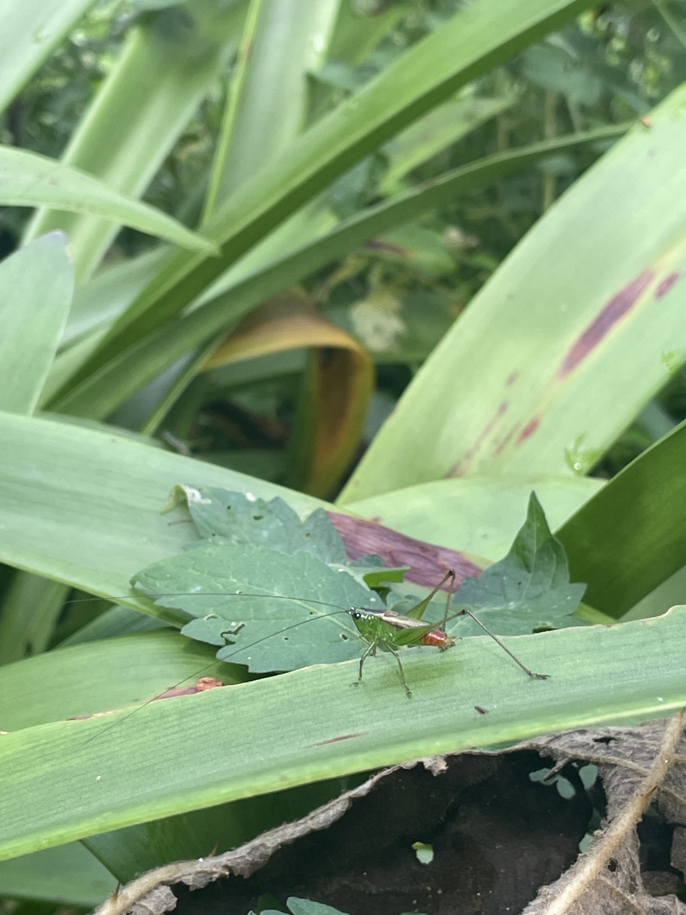
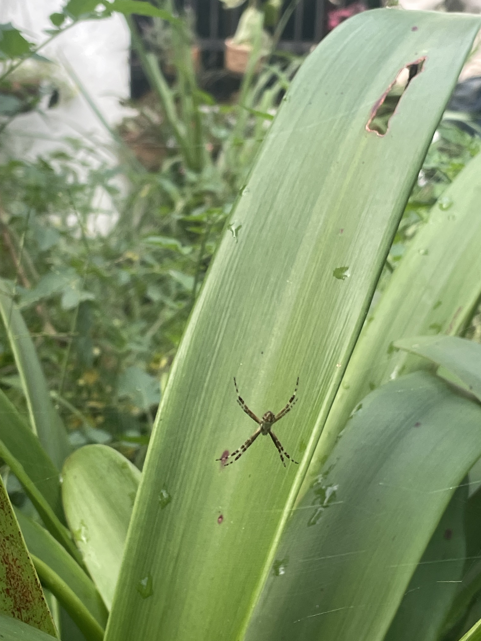
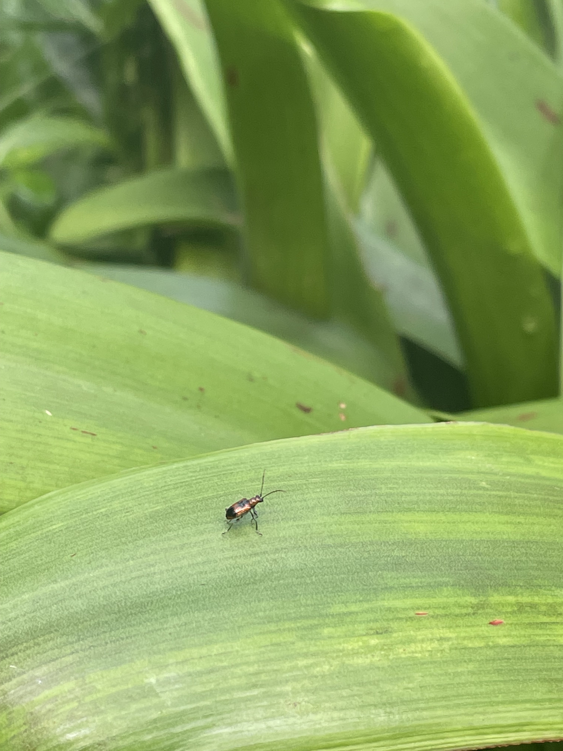
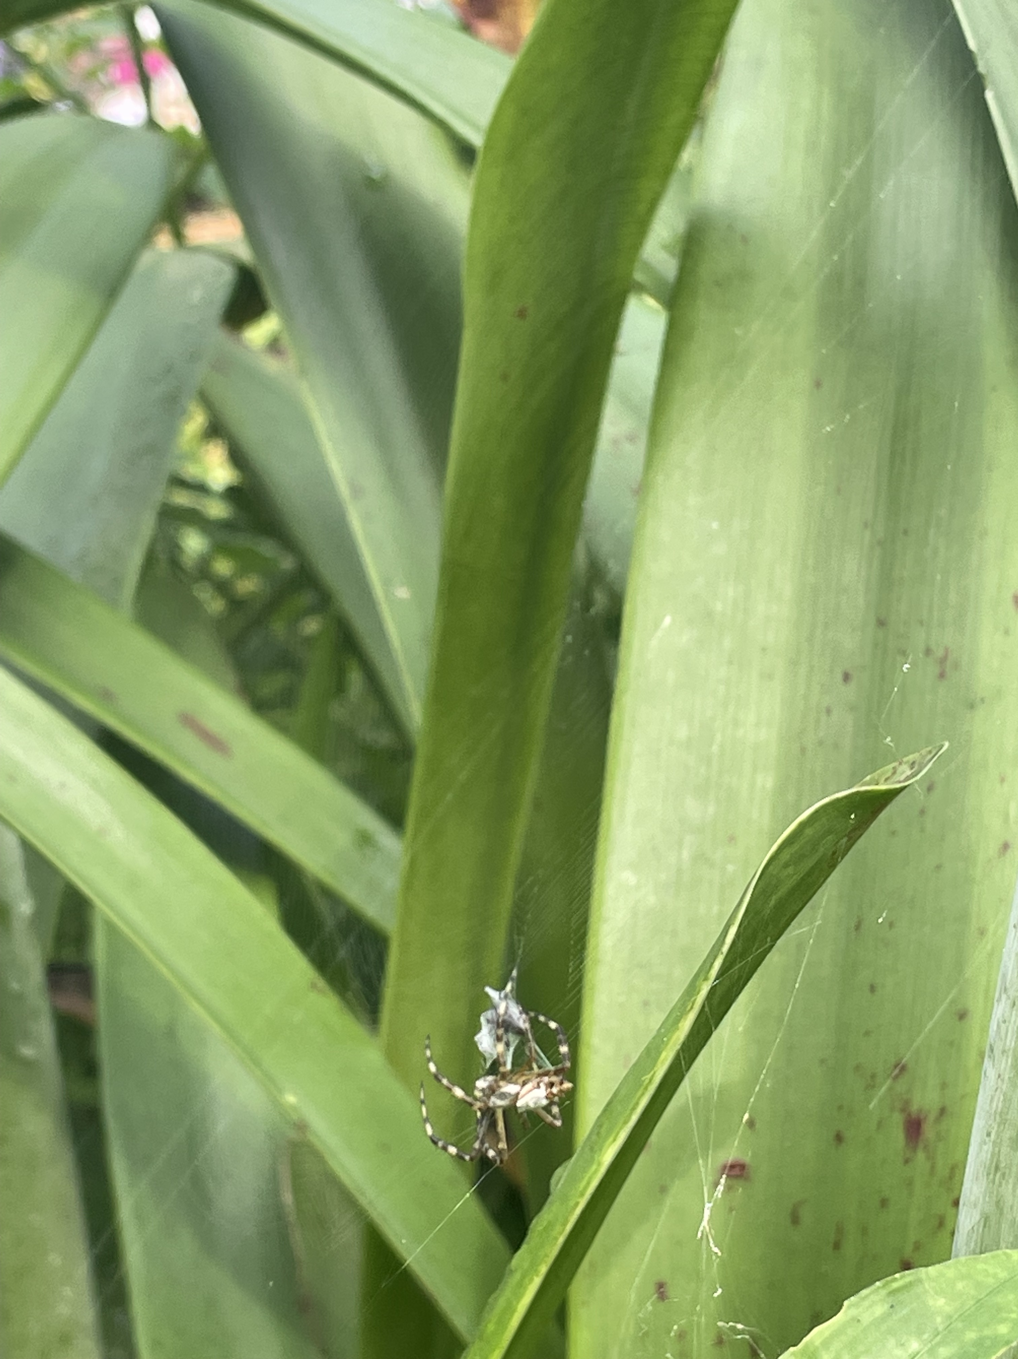
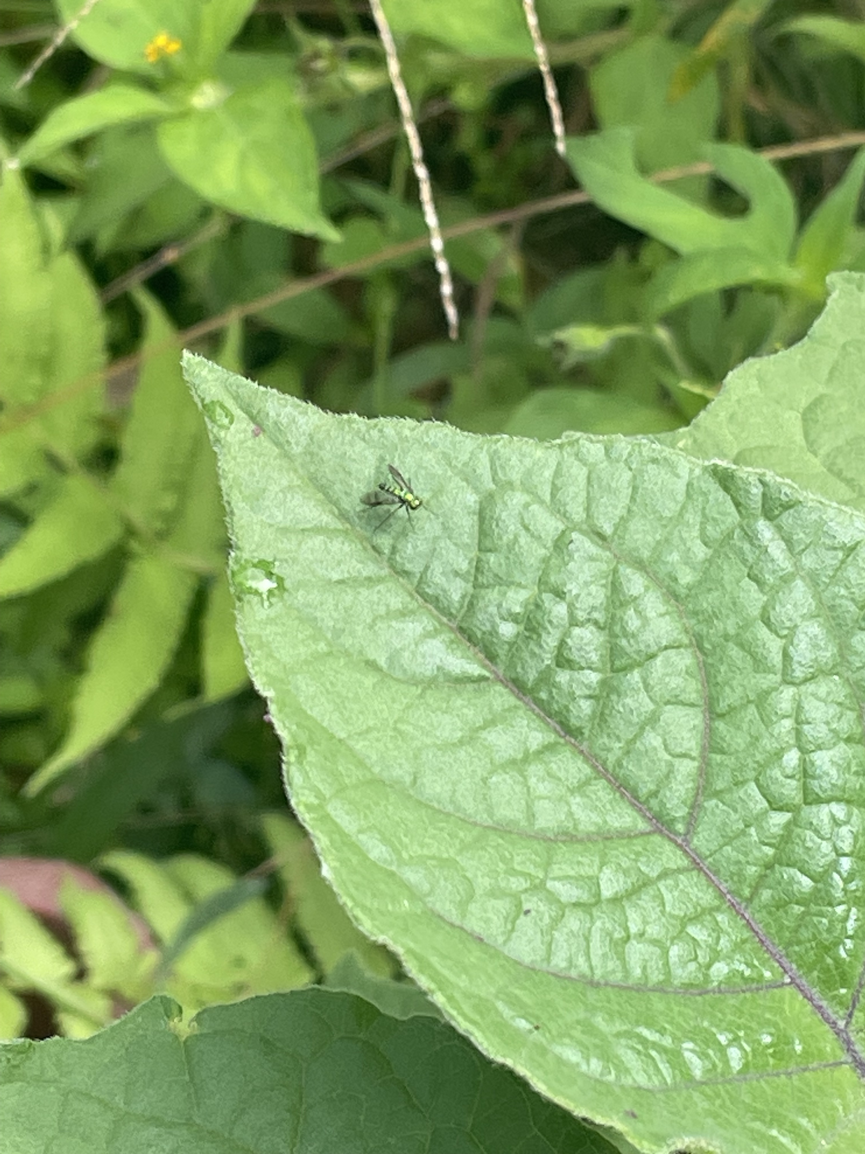

Slide 23
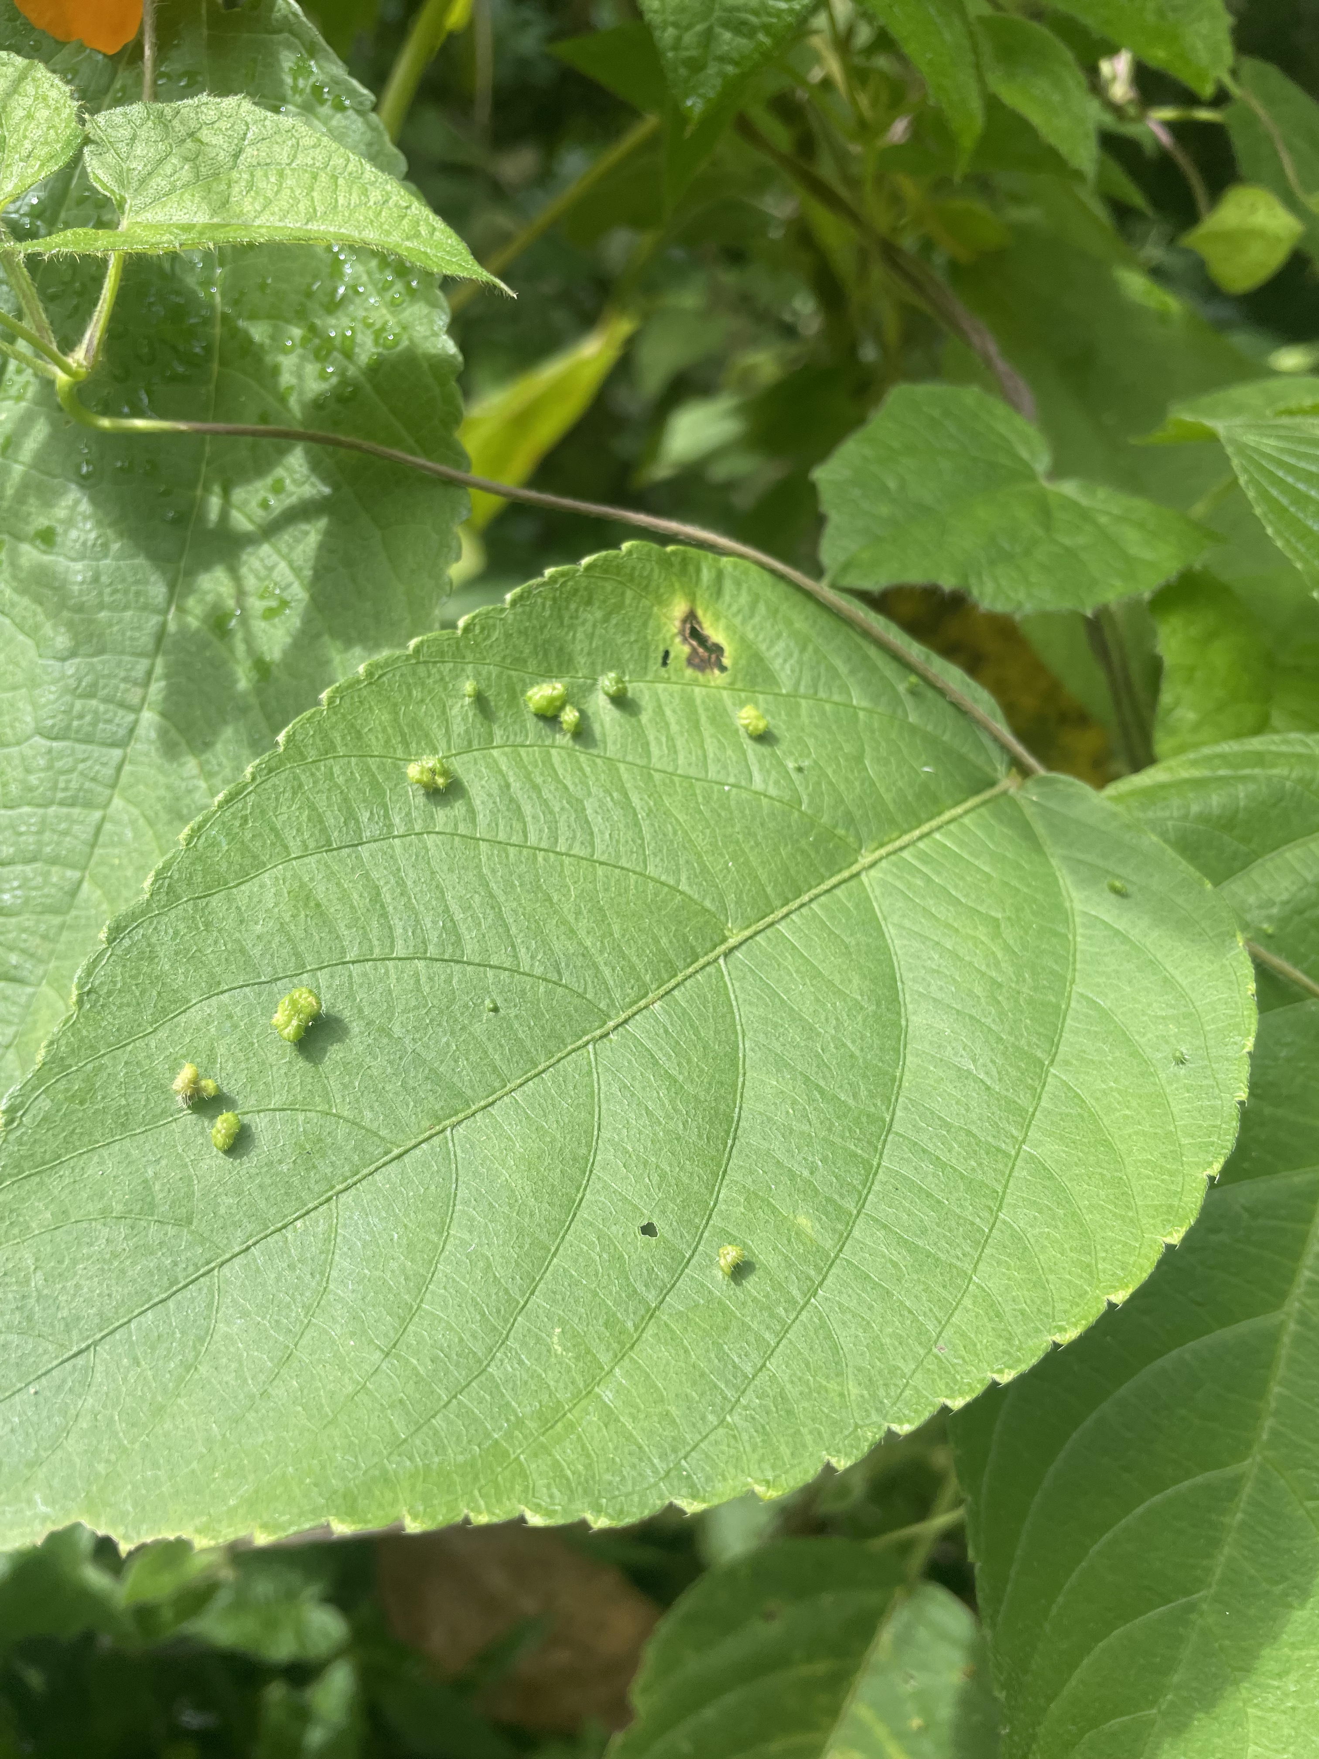
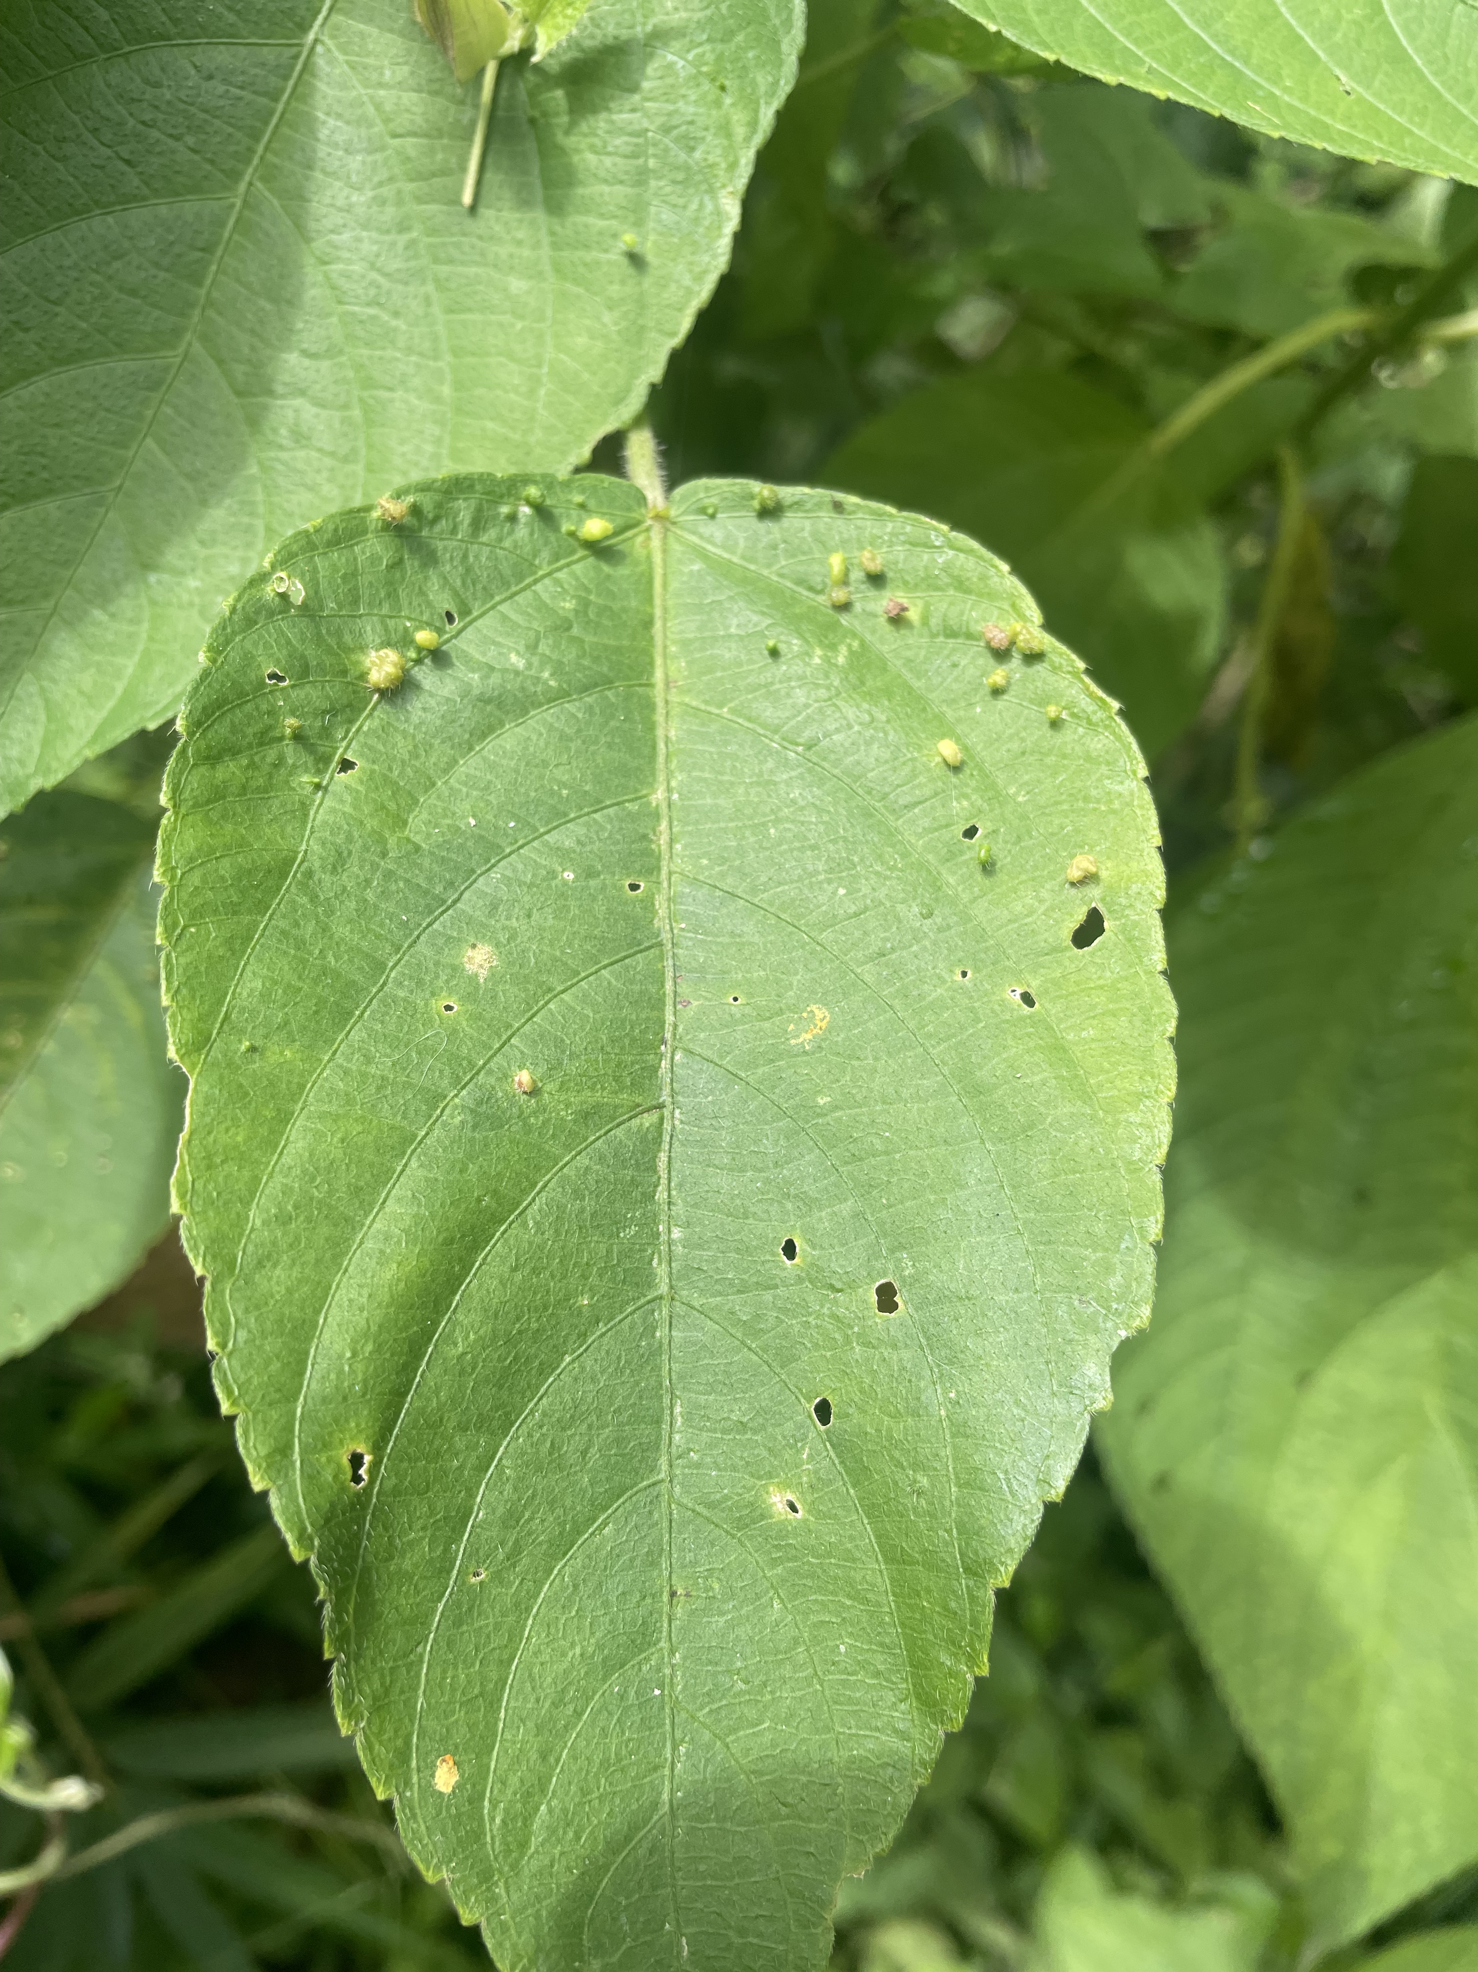
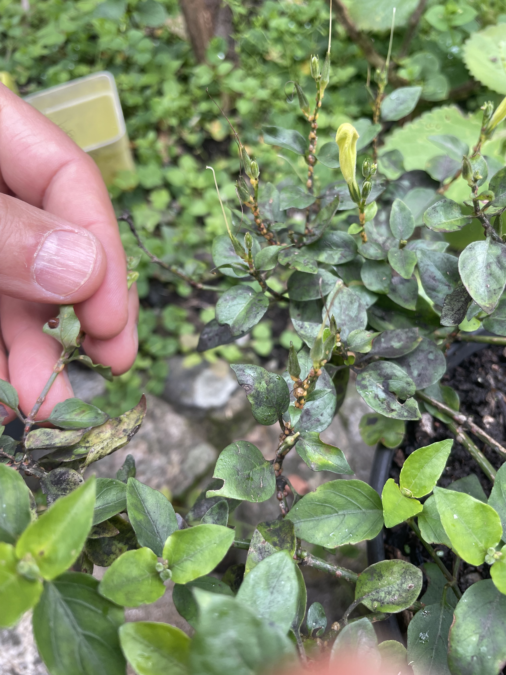

Slide 24
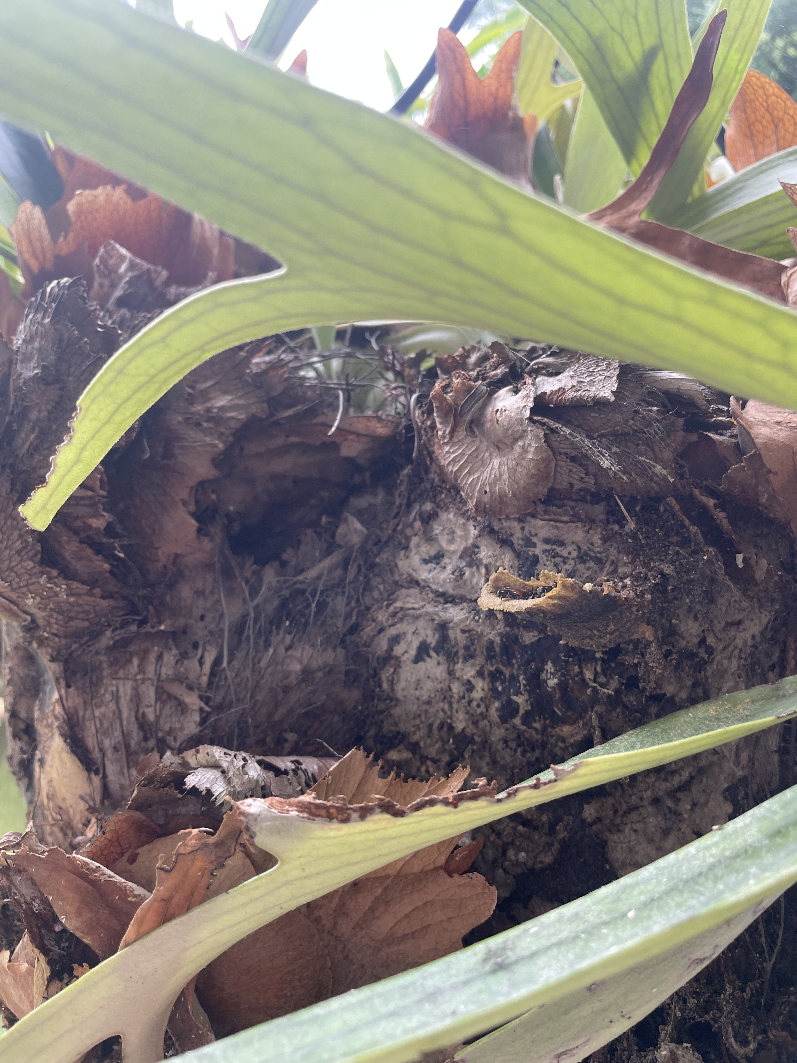

Slide 25
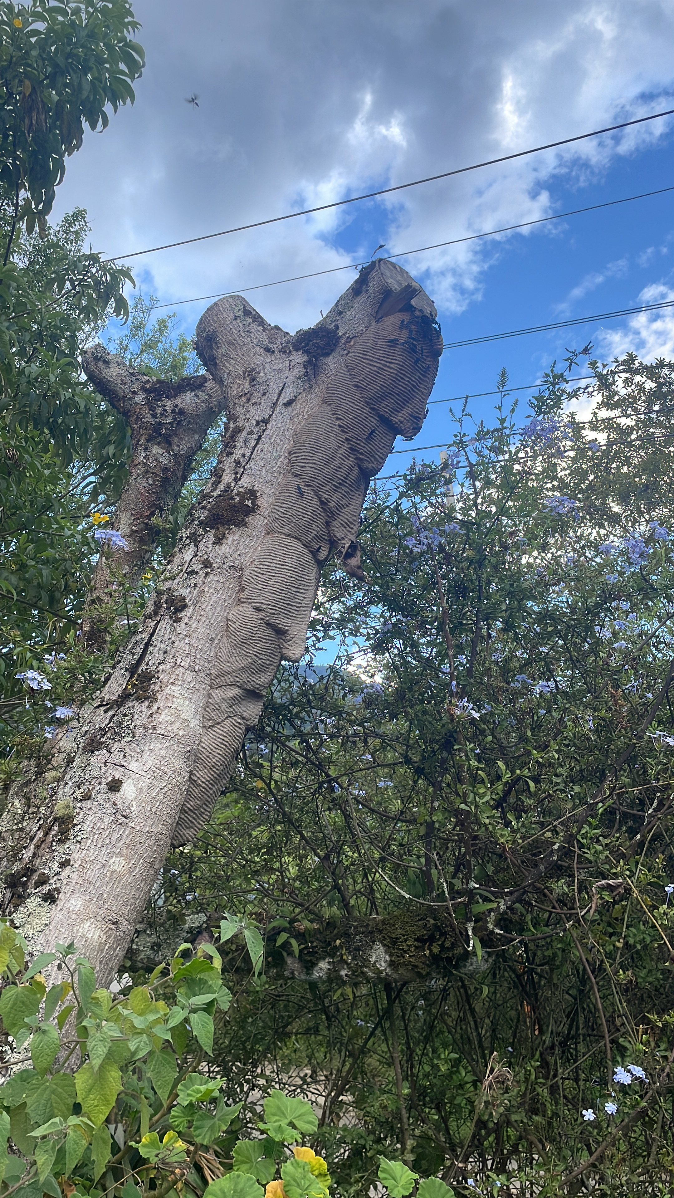
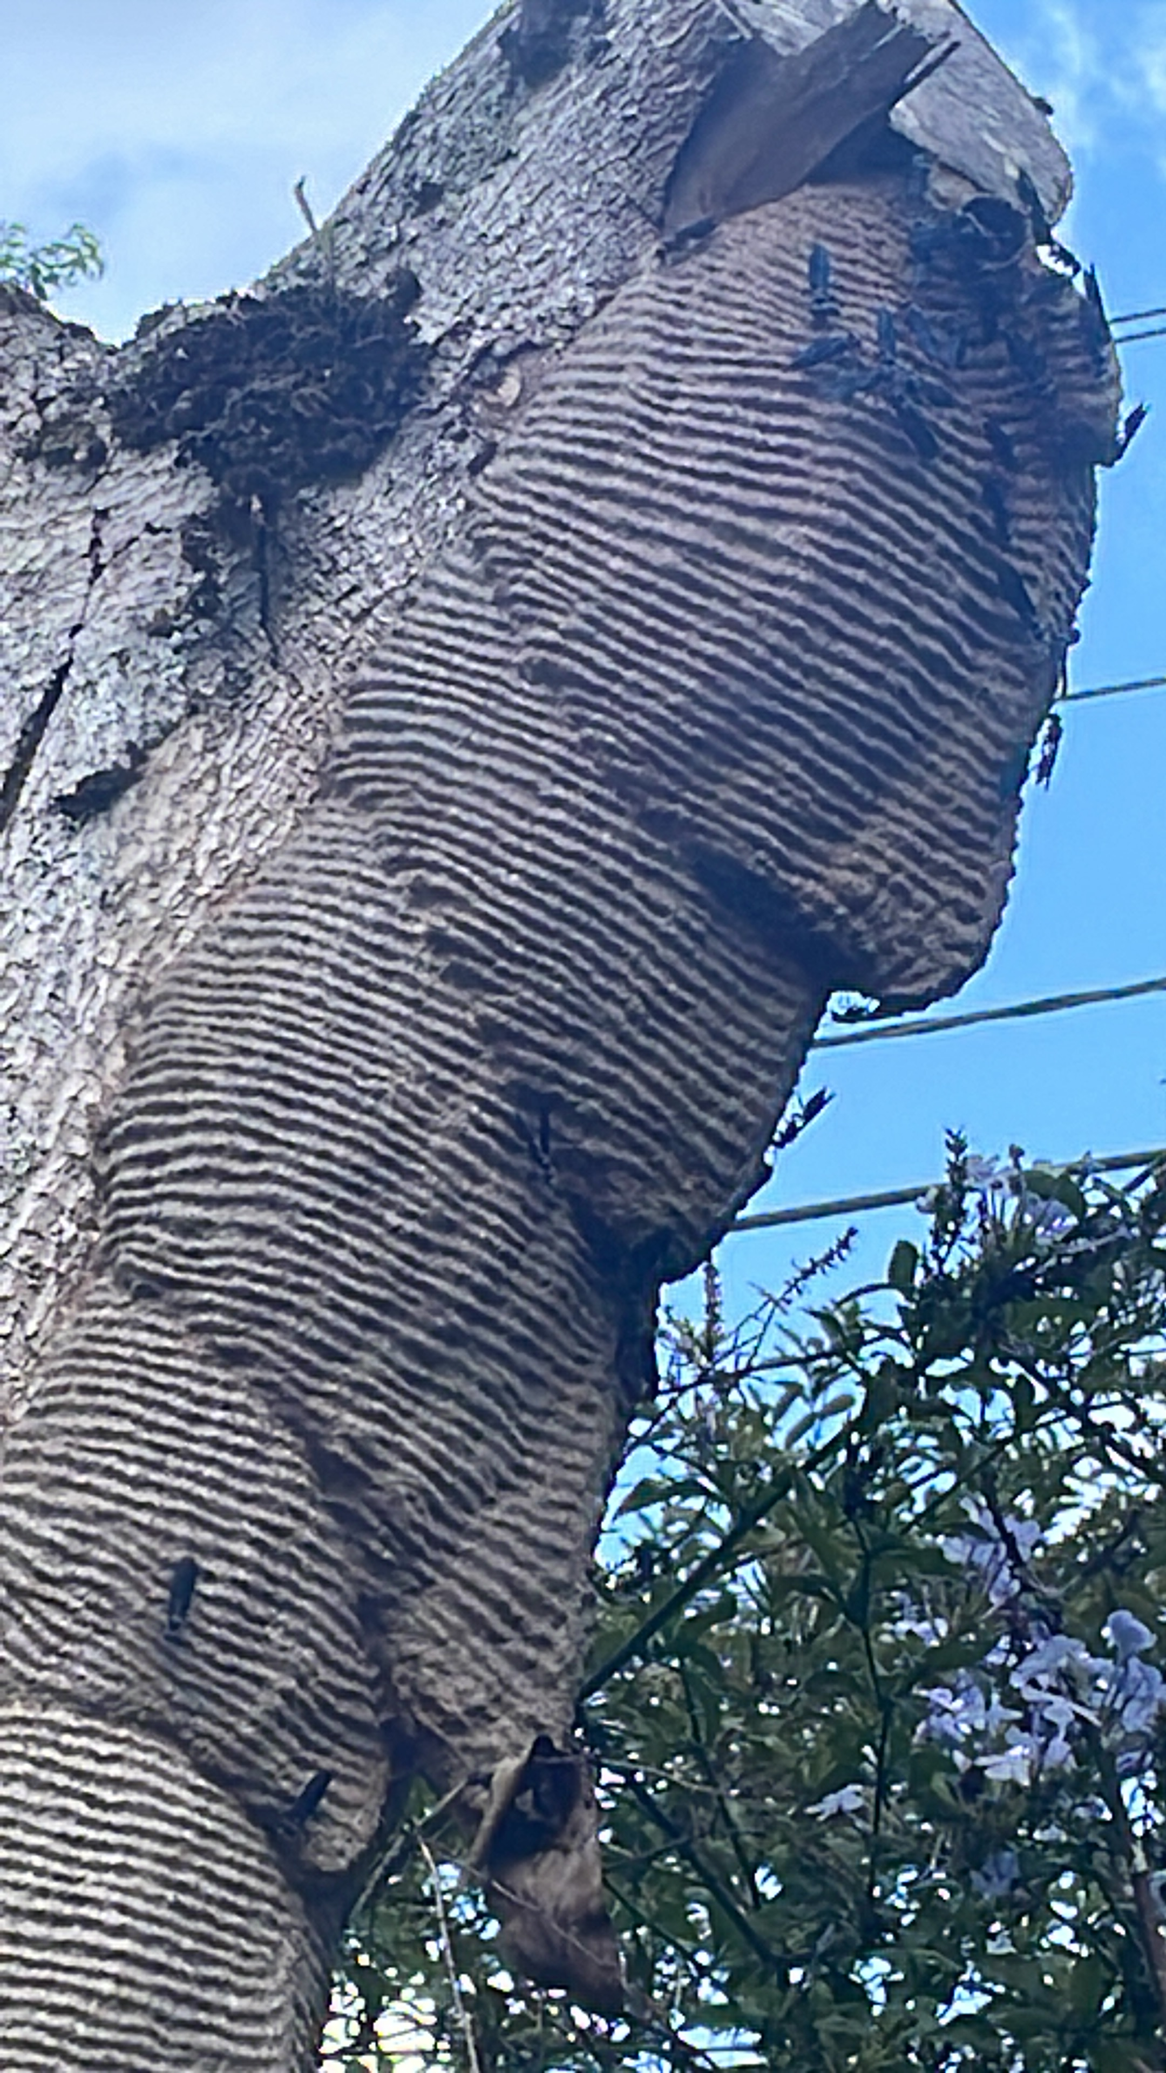
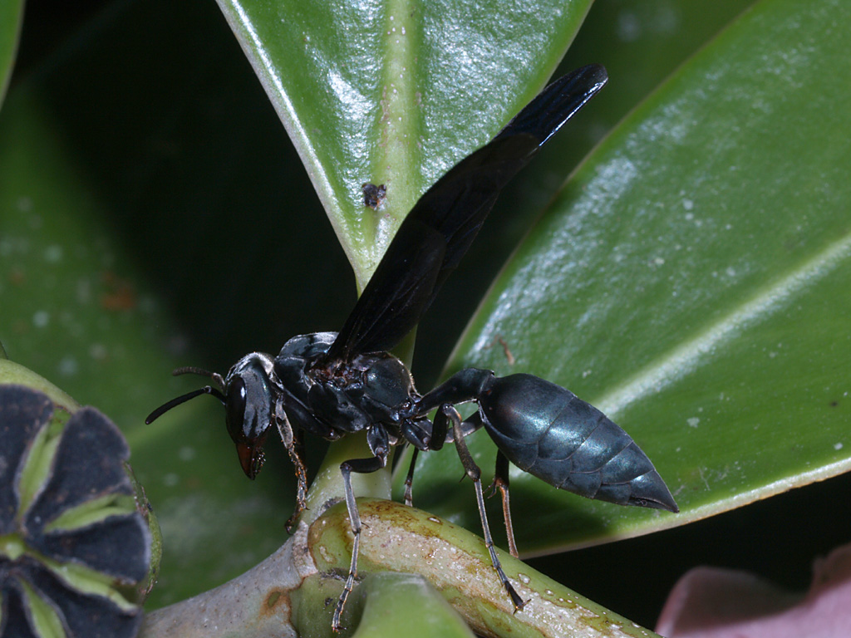
Warrior Wasp
S. septentrionalis is a 4 on his Schmidt sting pain index and has described it as "Torture. You are chained in the flow of an active volcano. Why did I start this list?” saying the pain lasts up to two hours.
Notes:
Entomologist Justin Schmidt has ranked the sting of the species

